Slide 1
Plastic Surgery ?
SW Rotary (Environment) 9th December 2021

Slide 2
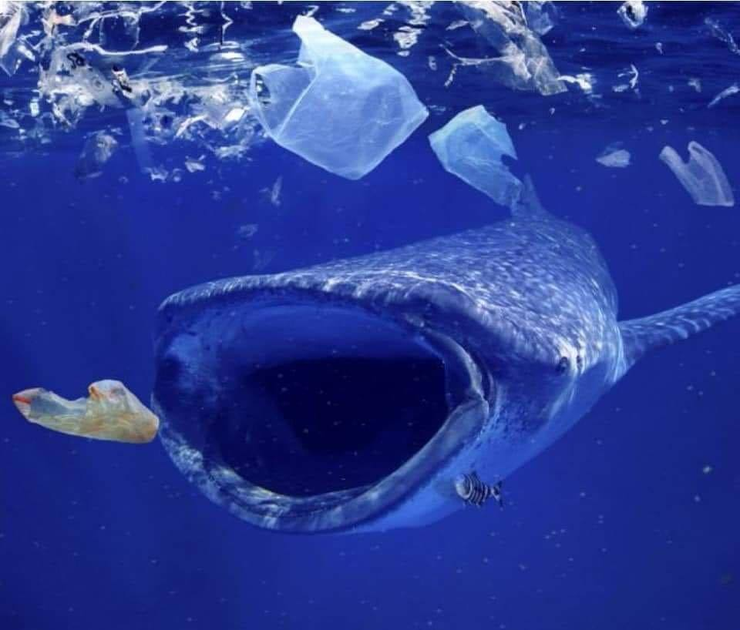
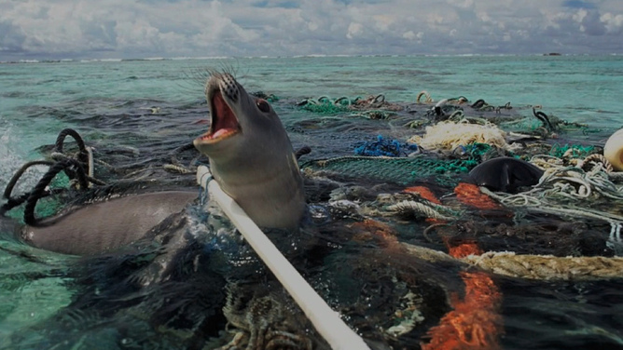
The images we have grown used to….
Taking action on Rotary’s newest priority.

Slide 3
Why ?
If we don’t take drastic action we’ll be ditching 33 million tonnes of plastic waste in to the environment by 2040.
It is in everything (from our food and water)
It is everywhere (from Everest to Antarctica)
From the micro-plastics from our washing machines
To the ‘nurdles’ that create more plastic products
And the ghost nets cut from fishing boats.
And, as an oil based product it contributes to the
climate emergency.
3

Slide 4
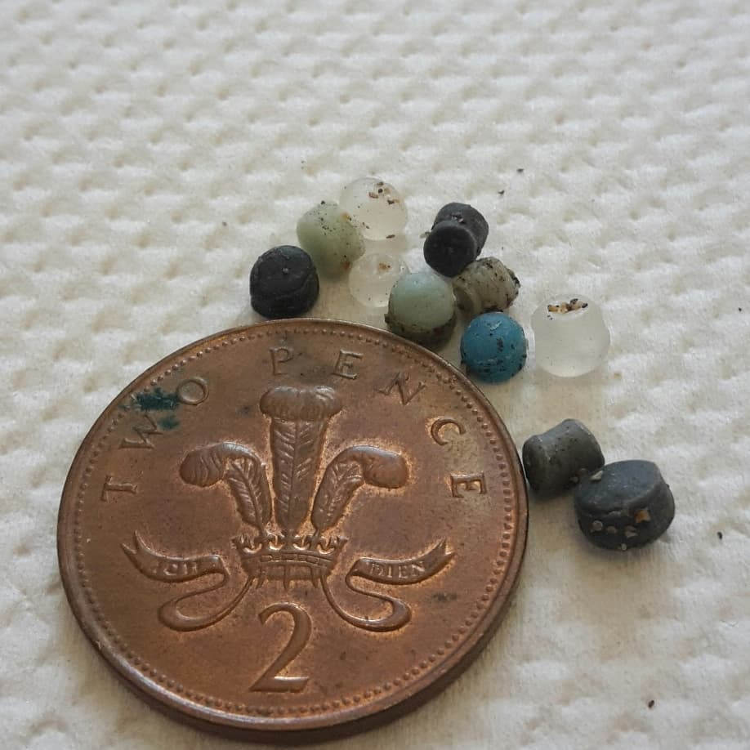
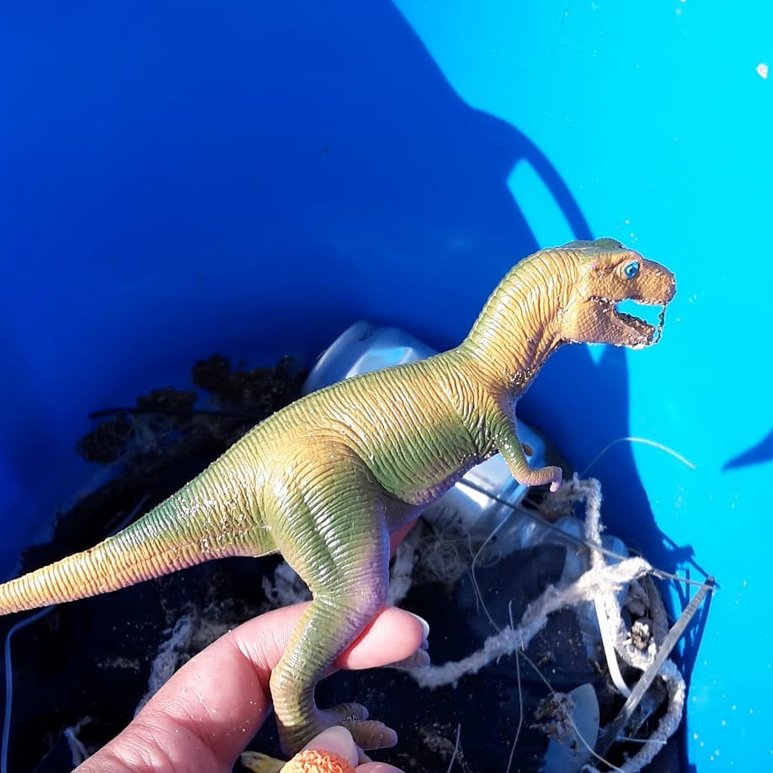
Pollution for Life
Plastic never really breaks down completely. It just gets smaller and more dangerous to wildlife.
Milk cartons take 5 years.
Cigarette Butts (12000 microfibres) take 10 to 12 years.
Foamed plastic cups take 50 years.
Plastic containers take 50 to 80 years.
Fishing line takes 600 years.
Plastic carrier bags take 200 to 1000 years.
Put in context…if you were a Roman soldier and you chucked away your water bottle on Hadrian’s Wall….the archaeologist finding it in 2021 might still be able to use it.

Slide 5
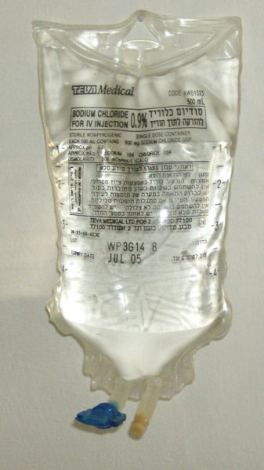
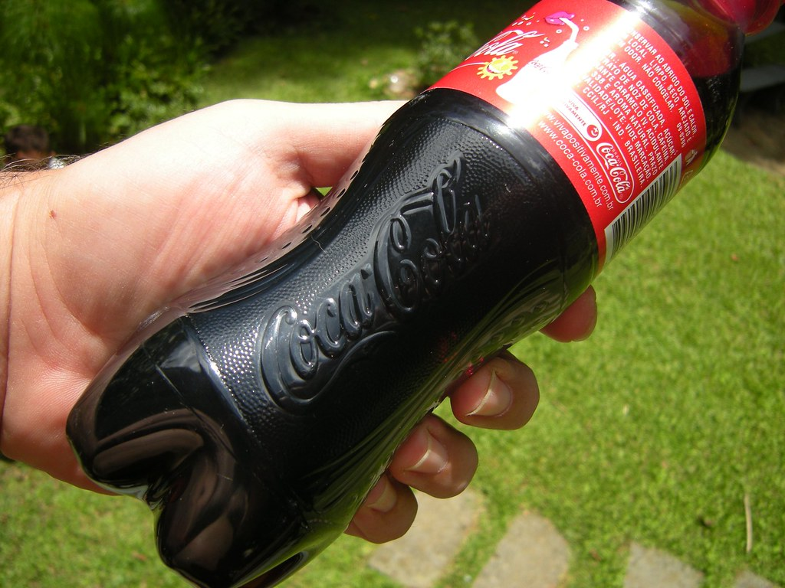
Isn’t it useful though ?
Yes…it was introduced about 80 years ago mainly to extend the life of food products.
It saves lives – think blood transfusions and PPE
It is light and transportable.
It can be reused and recycled.

Slide 6
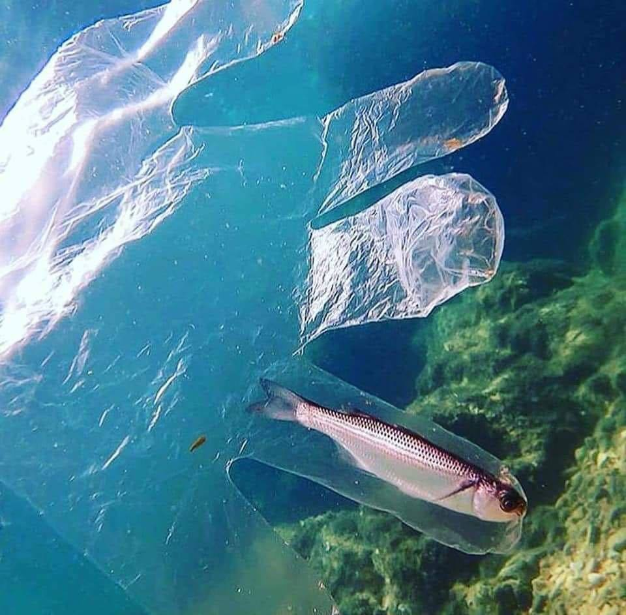
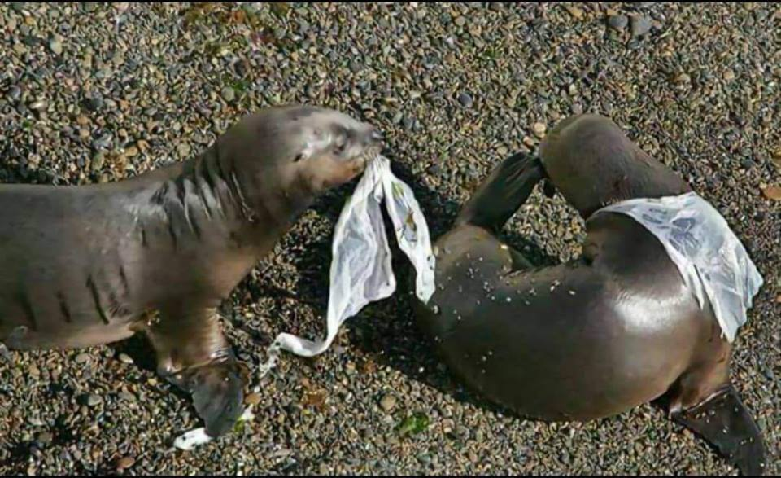
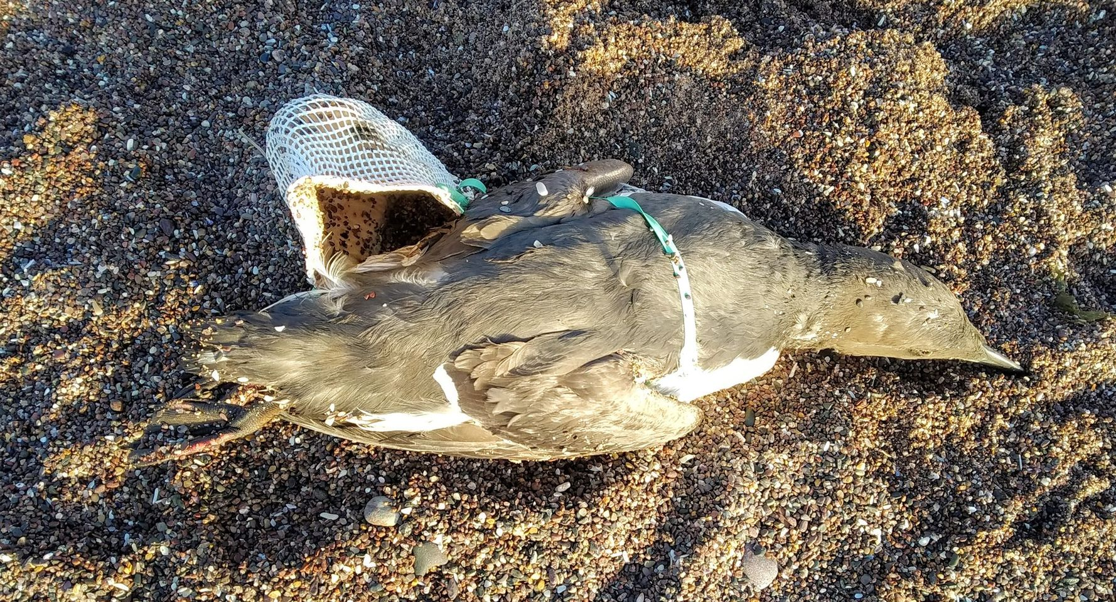
So what’s the problem ?
Put simply….we are. We don’t know when to stop.
We’ve grown too reliant on plastic
Single use plastic now makes up 50% of the plastic we throw away.
But globally….only 10% is recycled.
We still buy 1 million plastic bottles a minute. 9.3 million wet wipes, 500 billion carrier bags and we throw away 14 billion cigarette butts.
It kills over 100,000 marine animals every year and has been found in almost every dead seabird.

Slide 7
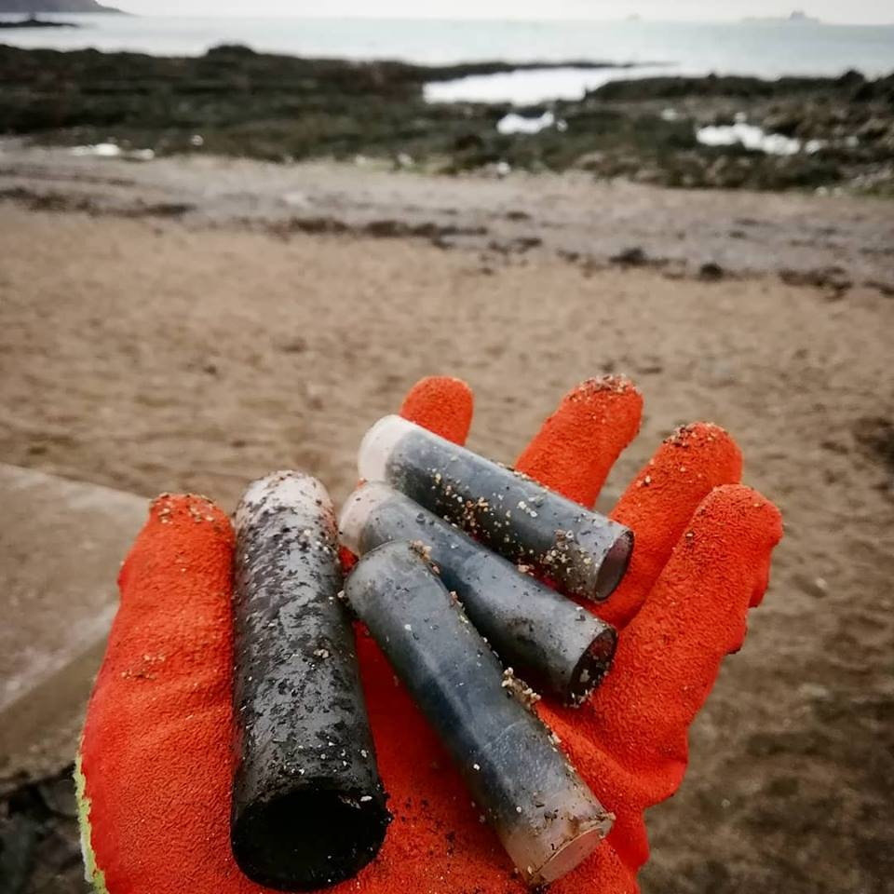
Are there solutions ?
Yes….some very easy ones…..will come on to those in the next slide but let’s start on some global ideas.
Fireworks – China and the EU have now banned plastic in fireworks.
Fines – In Corfu you have 3 chances. If caught with a carrier bag for a third time you can be asked to leave the island.
In Kenya you can be arrested for carrying a carrier bag.
Globally 95% of fleeces are made from recycled plastic.
The UK has recently banned the export of plastic waste to places like Malaysia and Singapore.
The problem is…we don’t have sufficient recycling processors to tackle the sheer amount we produce…..yet.
Products have been banned and more bans are on the way (Environment Act 2021)

Slide 8
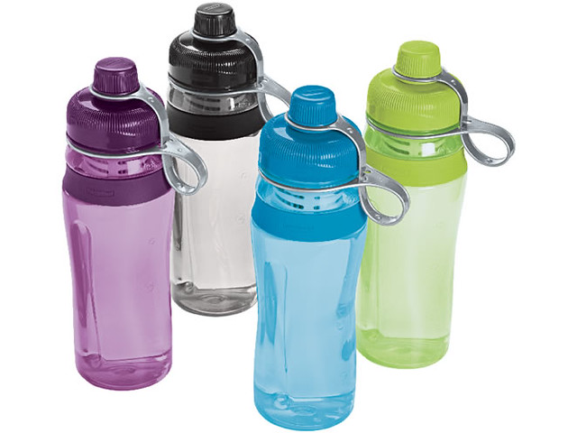
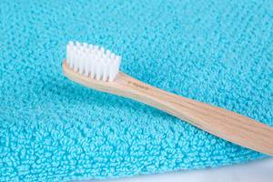
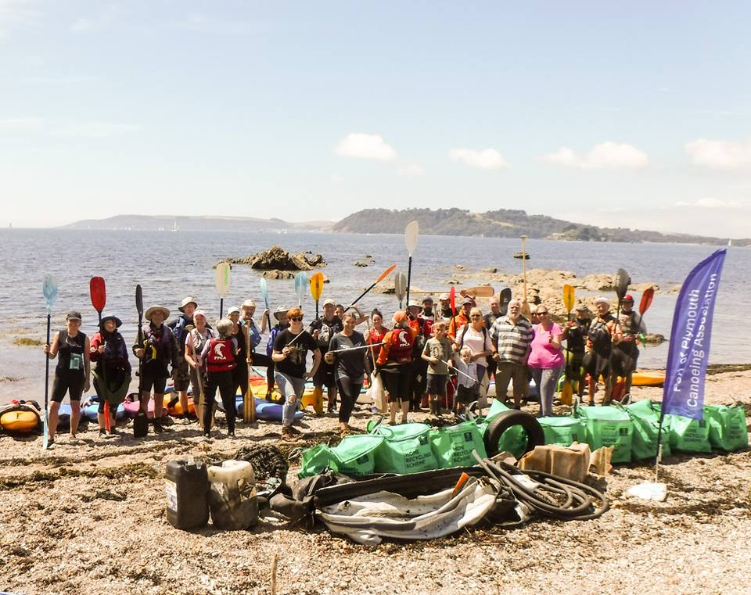
Action you can take…..
Invest in a reusable cup or bottle – each one replaces 170 SUP bottles.
Reject over packaged goods……especially if they have their own natural skins !
Buy reusable, refillable, recyclable – plastic can be ‘reused’ up to 5 times.
Use a bamboo toothbrush and/or biodegradable wet wipes…if you need to use them at all.
See if you can identify 3 SUP items to get rid of in favour of something more environmentally friendly.
Take part in a two minutes beach clean or litter pick or ‘find 3’ when you’re about and about.
Tell ten……lead by example

Slide 9
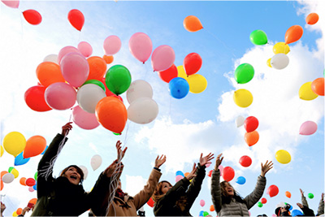
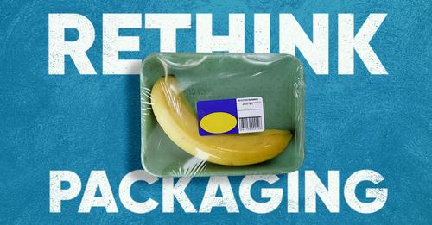
And as a Rotary Group ?
Encourage responsible behaviour and inspire others.
Lead by example…..For example for meals and celebrations……no balloon releases for example
Stick within the law – plastic stirrers, straws and cotton buds are now banned.
Plastic cutlery and plates may be next.
Support deposit and return schemes – milk deliveries ?
Take part in consultations – there is currently a Govt survey online to find out what you think as consumers.
Support your local Plastic Free Communities through Surfers Against Sewage (https://plasticfree.org.uk/ ). There are many groups in the South West…all needing volunteers and help.
Lead beach cleans and litter picks…even when you’re on your own or with the dog !

Slide 10
THANK YOU Contact : jyoung.urbanagenda@gmail.com with any questions you have or for future involvement in the campaign.
If we all do just one thing we can inspire the change we want to see and provide a better word for him……and for everyone.
Insert Image

